Slide 1
Recursion in Python
Week 5

Slide 2
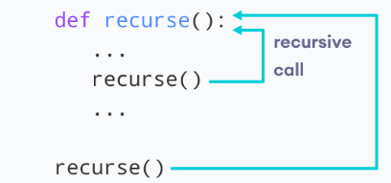
Python Recursive Function
In Python, we know that a function can call other functions. It is even possible for the function to call itself. These types of construct are termed as recursive functions.
The following image shows the working of a recursive function called recurse

Slide 3
What is recursion?
Recursion is the process of defining something in terms of itself.
A physical world example would be to place two parallel mirrors facing each other. Any object in between them would be reflected recursively.

Slide 4
Remember
"To understand recursion, you must first understand recursion",
"A human is someone whose mother is human".

Slide 5
What is recursion in Python?
Python also accepts function recursion, which means a defined function can call itself.
Recursion is a common mathematical and programming concept. It means that a function calls itself. This has the benefit of meaning that you can loop through data to reach a result.

Slide 6
Why do I need recursion?
You may want to split a complex problem into several smaller ones. You are already familiar with loops or iterations.
In some situations recursion may be a better solution.

Slide 7
Pitfall
The developer should be very careful with recursion as it can be quite easy to slip into writing a function which never terminates, or one that uses excess amounts of memory or processor power. However, when written correctly recursion can be a very efficient and mathematically-elegant approach to programming.

Slide 8
Recursion Example
In the tri_recursion(), it presents a function that we have defined to call itself ("recurse").
We use the k variable as the data, which decrements (-1) every time we recurse.
The recursion ends when the condition is not greater than 0 (i.e. when it is 0).
To a new developer it can take some time to work out how exactly this works, best way to find out is by testing and modifying it.

Slide 9
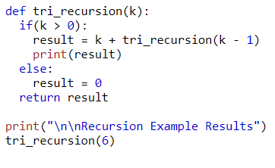
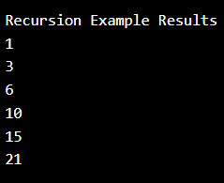
Recursion example

Slide 10
Doing Factorials
Factorial of 5:
5! = 5 × 4 × 3 × 2 × 1 = 120
Factorial of 7:
7! = 7 × 6 × 5 × 4 × 3 × 2 × 1 = 5,040
Factorial of 0:
0! (by definition) = 1
Factorial of 10:
10! = 10 × 9 × 8 × 7 × 6 × 5 × 4 × 3 × 2 × 1 = 3,628,800

Slide 11
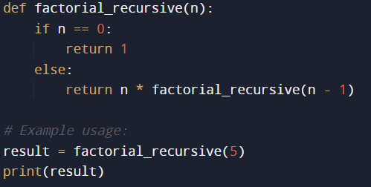
Factorials
Recursion can be a more favorable solution than iteration in certain problems, especially when the problem naturally exhibits a recursive structure.
One classic example where recursion is often more elegant and intuitive is in calculating the factorial of a number.
The factorial of a non-negative integer n, denoted as n!, is the product of all positive integers from 1 to n.

Slide 12
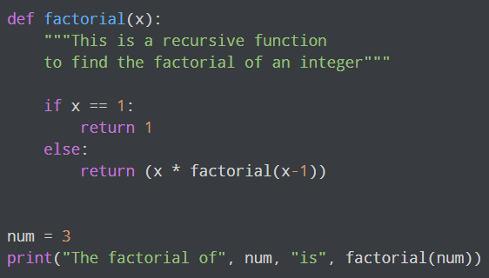

Example
Factorial of a number is the product of all the integers from 1 to that number. For example, the factorial of 6 (denoted as 6!) is 1*2*3*4*5*6 = 720.

Slide 13
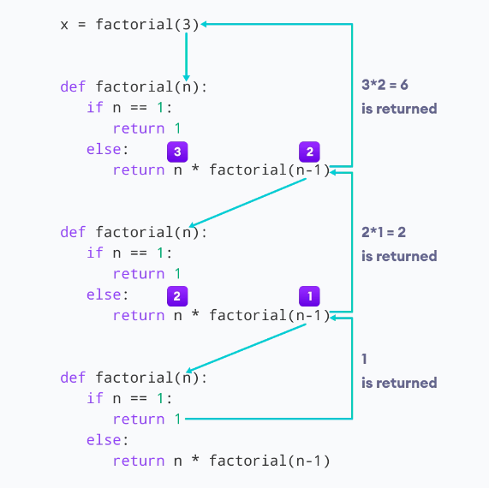
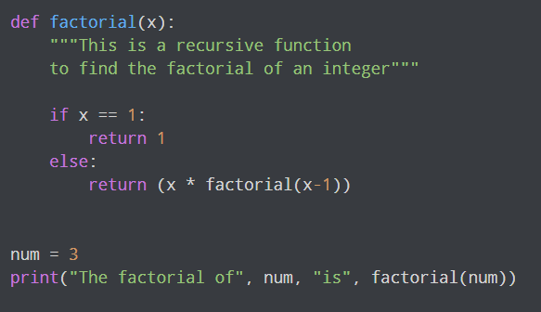
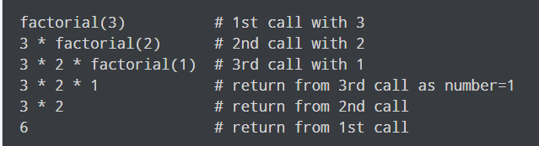
Our recursion ends when the number reduces to 1. This is called the base condition.
Every recursive function must have a base condition that stops the recursion or else the function calls itself infinitely.
The Python interpreter limits the depths of recursion to help avoid infinite recursions, resulting in stack overflows.
By default, the maximum depth of recursion is 1000. If the limit is crossed, it results in RecursionError. Let's look at one such condition.

Slide 14
Advantages of Recursion
Recursive functions make the code look clean and elegant.
A complex task can be broken down into simpler sub-problems using recursion.
Sequence generation is easier with recursion than using some nested iteration.

Slide 15
Disadvantages of Recursion
Sometimes the logic behind recursion is hard to follow through.
Recursive calls are expensive (inefficient) as they take up a lot of memory and time.
Recursive functions are hard to debug.

Slide 16
Why and when is a recursion favorable?
In the previous example, the factorial_recursive function calls itself with a smaller value (n - 1) until it reaches the base case where n is 0. At that point, it returns 1 (the factorial of 0), and the recursion "unwinds," multiplying each result to calculate the factorial of the original number.
Recursion can be a more favorable solution in this case because it naturally mirrors the mathematical definition of factorial and makes the code more readable and concise. While you can calculate factorials iteratively using a loop, it tends to be less intuitive and more verbose.
However, it's important to note that recursion has limitations, particularly related to stack overflow errors for large inputs, so it may not be the most efficient solution in all scenarios. In such cases, an iterative approach or memoization (caching previous results) may be more suitable.

Slide 17
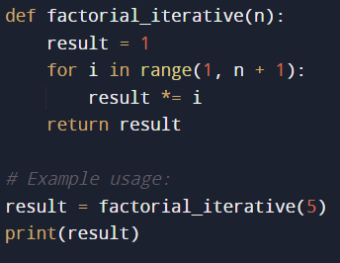
Recursion vs a For loop

Slide 18
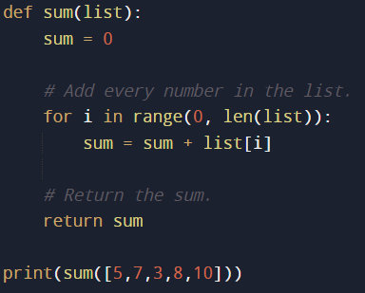
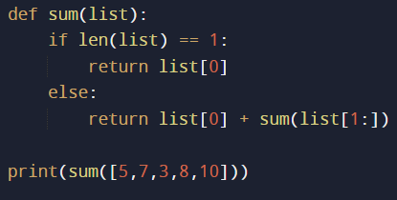
Recursion in a List

Slide 19
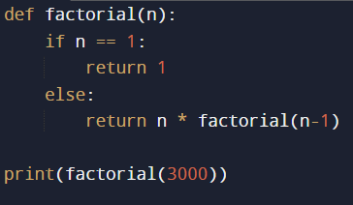
Limitations
Every time a function calls itself and stores some memory. Thus, a recursive function could hold much more memory than a traditional function.
Python stops the function calls after a depth of 1000 calls. If you run this example:

Slide 20
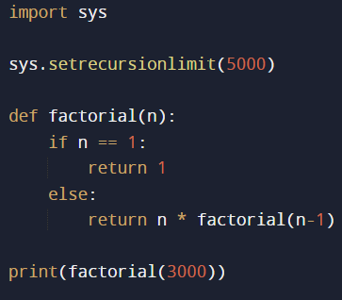
It can crash!
In other programming languages, your program could simply crash. You can resolve this by modifying the number of recursion calls such as
but keep in mind there is still a limit to the input for the factorial function. For this reason, you should use recursion wisely.
As you learned now for the factorial problem, a recursive function is not the best solution.
For other problems such as traversing a directory, recursion may be a good solution.

Slide 21
Uses and implementations of Recursion
Fibonacci Number Sequence
Binary Tree Traversal
Tower of Hanoi
Calculation Exponents
Computing GCD
Permutations and Combinations
Maze Solving
Fractals

